Slide 1
The little thing called MicroBurst - A real world case
2016-10-19
Christian Reusch
Systemprogrammer Network

Slide 2
Agenda
The Problem
Analyzing the Problem
Typical “Micro Burst“ scenarios
Summary

Slide 3
The problem
A flat network with a lot of peer to peer communication
Max. 1% used bandwidth in that FastEthernet network

Slide 4
The problem
But imagine a hierarchical Network Application in a Fast Ethernet network
Still max. 1% used bandwidth in a Fast Ethernet network

Slide 5
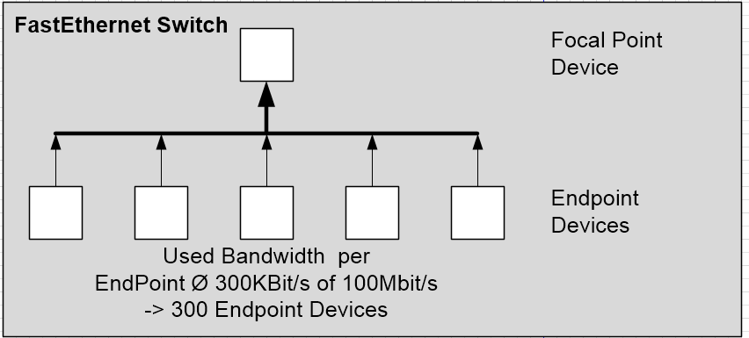
The problem
We run a small test:
The goal is: How much devices can be handled by the application (focal point)
Expected value: More than 1000 simulated devices

Slide 6
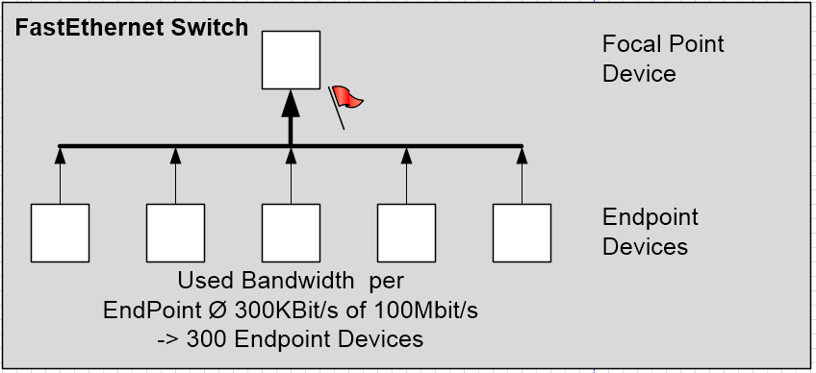
The problem
But if we reach half of the expected traffic
We got massive packet loss in the application logs
The used bandwidth is still < 1 Mbit/s at every point
The switch does not show any drops
Who is to blame?
Application?
Network?

Slide 7
Analyzing the problem
We captured the traffic at points marked with the:
We see massive packet loss in the traces
The maximum traffic is still below 1 MBit/s
The traffic has bursts
The switch counters does not telling the truth (issue)
Why do we see this massive packet loss?

Slide 8
Analyzing the problem
Let´s have a look at: “How the frames are transmitted over the network!”
How fast a Bit is transmitted over the network depends on the speed of the network itself (1GBit/s is 10 times faster then 100 Mbit/s)
As a result of this border, we have a minimum delta time between the start of two frames

Slide 9
Analyzing the problem
Framegap calculator (practical Demo)

Slide 10
Analyzing the problem
DEMONSTRATION

Slide 11
Typical MicroBurst Scenarios
Scenario LAN - WAN
Heterogeneous networks with different Bandwidths (LAN – WAN)
SLA for WANs is often defined like that: 10 Mbit/s But what happens, if the 10 Mbit per second will be transmitted as a peak of 20Mbit in 500ms?

Slide 12
Typical MicroBurst Scenarios
Scenario LAN-WAN Mitigations:
Be prepared while negotiating the SLA
Use larger buffers, but be careful (Risk of Bufferbloat)
Implement QOS (Quality of Service) policies
Traffic priotization -> But packet loss can not avoided with QOS
Enhance the WAN Bandwidth
Try to avoid MicroBursts

Slide 13
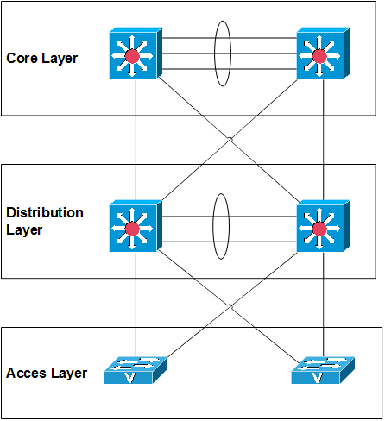
Typical MicroBurst Scenarios
Scenario LAN
In the past: Access Layer Links -> 10 MBit/s Distribution Layer Links -> 100 MBit/s Core Layer Links -> 1000 Mbit/s
Nowadays: Access Layer Links -> 1 GBit/s Distribution Layer Links -> 1 GBit/s Core Layer Links -> 10 Gbit/s

Slide 14
Typical MicroBurst Scenarios
LAN Mitigations:
Some switches allow 100 Mbit/s autoneg.
Uplinks needs more Bandwidth than a downlink port
Best Practice: (Uplinks: ~half of the switching capacity) -> Use higher Bandwith or Etherchannels
24 Port Gbit/s Switch -> 10 Gbit/s Uplink capacity
QOS (Qualitiy of Service)
Traffic priotization -> But packet loss can´t be avoided by QOS

Slide 15
Typical MicroBurst Scenarios
Industrial Ethernet
Often hierarchical communication
Every device must communicate with the Controller
Often only FastEthernet networks
Small packets
Short communication interval
Often Packet loss is not tolerated
Often Profinet protocol is used
Sometimes UDP with properity protocols

Slide 16
Typical MicroBurst Scenarios
Industrial Ethernet Mitigations
Use Gigabit Uplinks and in the Backbone
Use Realtime protocols like Profinet IRT (Isochronous-Real-Time) -> special kind of Quality of Service -> all devices must support this

Slide 17
Summary
Nowadays more common then in the old days, especially in the LAN
Not only the average amount of traffic per second is interesting
The average amount of traffic in every ms is interesting, too -> ”Micro Burst”
At Uplink- or WAN-Ports you should keep an eye at the ”Micro Bursts”
The number of packets is also interesting, when we look at the network performance
Precise capture equipment/setup is recommended, for that kind of analysis

Slide 18
Thanks! Question?
Email: creusch@crnetworks.de
Blog: crnetpackets.com
Twitter: @crnetpackets

Slide 19
Some Chapter Text

