Slide 1
Back to Basics
Youtube/hansangb
https://app.box.com/v/HSBBook
Twitter: @hansangb

Slide 2
About me?
Been at it long time
Can’t learn in a day
But you can build the foundation
Read….READ I SAY!!!!

Slide 3
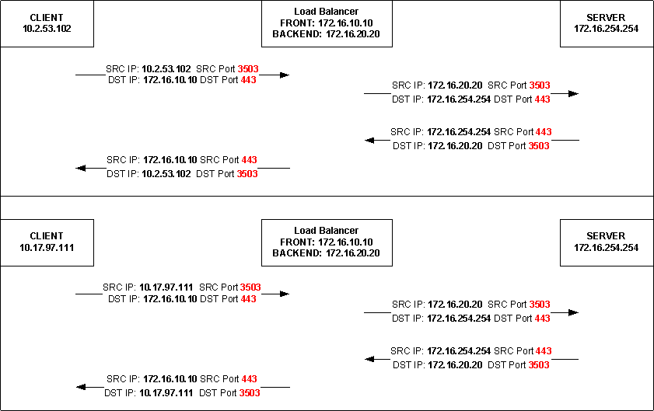
About me?

