Slide 1
Maintaining Dissector Quality
Martin Mathieson
Keysight
Notes:
Ask how many people have done C/C++? Anyone worked on dissectors? Not to worry – not going to teach dissector development, but will give you a good idea of how fields are added, the process, and how the community can amplify your efforts.
Many people have worked over the years to improve the quality of our dissectors. I’ve done some work recently to add some extra checks – though I don’t want to overstate the importance of what I’ve done.
Will show how Wireshark can add fields, and that if you work on a protocol that ought to be upstream, the community can help you make it better.

Slide 2
Intro/Me
Long time user and contributor to Wireshark
Notes:
Have long thought of myself as a “persistent contributor, but have tried some things now to help with actual maintenance. Try to help with reviews and have done some things to find problems across the whole collections of dissectors.

Slide 3
Intro/Me
Long time user and contributor to Wireshark
Obscure Telecoms Protocols
Notes:
I have mostly worked on testing Telecoms (VoIP, 3G, 4G, 5G), which often involves standard (3GPP/IETF/O-RAN) protocols - sometimes I add new dissectors or functionality for these protocols.
These are relatively obscure.
In the early days used to do lots of quick and dirty temp changes see what was going on (along the lines of what Chuck was showing you can do with Lua)

Slide 4
Intro/Me
Long time user and contributor to Wireshark
Obscure Telecoms Protocols
More Obscure internal Wireshark builds
Notes:
Often want to see company-internal logs/messages, so for a long time have written internal dissectors and distributed internal Wireshark kits:
Currently have 13 internal dissectors
Sometimes not relevant for long
Sometimes I am the only user!
Often these will be internal framing protocols that call the same telecoms dissectors above
Some ‘general’ but not standard, e.g.
IP-over-UDP
Text-logger for finding logged text inside TCP streams
Have created file-format support, command-line utilities only of local significance
Ciphering algorithms that may not be distributed by project because of legal restrictions
Thanks to Huang for adding the Protobuf dissector!
These changes usually prove to be useful, but not suitable for contributing to project.

Slide 5
Intro/Me
Long time user and contributor to Wireshark
Obscure Telecoms Protocols
More Obscure internal Wireshark builds
But everyone uses mainstream protocols
Notes:
My contributions to mainstream protocols are usually not purely decoding fields, but to see information quickly that I want to know.
Can be particular to how we use them
analyzing multiple TCP streams carried over the same frame
Long-running TCP streams (window scaling without seeing handshake)
TCP SACK graph (had competing transport layer running over TCP – needed to analyze both
Detecting duplicate IP addresses
Matching ICMP ping request/responses
TCP is important and interesting, but I’m lucky if I see one interesting TCP trace/case per year… Takes time, but can usually work it out.

Slide 6
Intro/Me
Long time user and contributor to Wireshark
Obscure Telecoms Protocols
More Obscure internal Wireshark builds
But everyone uses mainstream protocols
Benefitted from contributing changes!
Notes:
Avoid duplication of effort
For one of WiMAX protocols I found 3, and worked with one that looked best to get ready for merging
People send you interesting capture files
Worth the effort to make them accessible, e.g. for protocols that can’t be captured by standard stacks/drivers
E.g. MAC for LTE air interface, added example program to send with UDP framing that I wasn’t using
Added a DLT method that has been used by openLTE and possibly other projects
Saw an open-source LTE sniffer that uses it
Sometimes interesting to see protocol adoption
Managers sometimes ask me if people started updated or asking about parts of standards

Slide 7
Agenda
Dissectors
Notes:
Will say something about what a dissector is (context for the maintenance I will describe). But also mention that our collections of dissectors are priceless. You couldn’t pay anyone to write them at the time like the adopters of the protocol who need to see the details but can’t yet!

Slide 8
Agenda
Dissectors
Quality?
Notes:
What do we (as users and developers) care about?

Slide 9
Agenda
Dissectors
Quality?
Stages of development
Notes:
In terms of what happens when. Opportunities to fix problems that we might detect

Slide 10
Agenda
Dissectors
Quality?
Stages of development
General checks
Notes:
These are things are could be applicable to any software project, but may be more pressing for a large, maturing project like Wireshark.
A large number of files in the same folder written by many people over several years packaged into one lib

Slide 11
Agenda
Dissectors
Quality?
Stages of development
General checks
Specific checks
Notes:
Checks that are specific to dissector development - “Project-specific Linting”
Checks that the C compiler alone can’t do. A different discussion to say that we could have C++ interfaces that make many of these problems compile-time…

Slide 12
Agenda
Dissectors
Quality?
Stages of development
General checks
Specific checks
Observations/discussion
Notes:
Will recap and give some observations of my own, would love to have some discussion.

Slide 13
Dissectors
C code to show 1 protocol
Notes:
C code to show one protocol
APIs for:
Registering fields, subtrees, expert info
Callbacks for registering, dissecting frames, updating preferences,
Dissecting: Creating subtrees, items, updating columns, expert info, taps, etc
Conversation tracking, re-assembly, request/response tracking
More custom code for decryption, sequence number analysis, etc

Slide 14
Dissectors
C code to show 1 protocol
~244,000 fields in ~2,900 dissectors, ~4M LOC?
Notes:
Lots. Copied numbers from Gerald’s talk…

Slide 15
Dissectors
C code to show 1 protocol
~244,000 fields in ~2,900 dissectors, ~4M LOC
~2,100 Authors
Notes:
Lots of authors turn up to only add or fix the protocol that they need. Their interests may then move on (change employers, no longer work with that protocol). Even among core developers, some are busy for long periods then take a break, etc

Slide 16
Dissectors
C code to show 1 protocol
~244,000 fields in ~2,900 dissectors, ~4M LOC
~2,100 Authors
No retirement policy
Notes:
No real retirement policy…
Small number removed that were abandoned and never standardised
AOL chat shut down years ago
I don’t know if other projects still use protocol without AOL servers?
People might still study want to old captures?
Should they use current Wireshark release?

Slide 17
Dissectors
C code to show 1 protocol
~244,000 fields in ~2,900 dissectors, ~4M LOC
~2,100 Authors
No retirement policy
Should prioritise effort by “Popularity” ?
Notes:
Some dissectors are more prevalent than others. Some are commonly used and complex. So fixing errors in those dissectors delights users more. But more effort is already being spent on those dissectors
Hard to accurately measure popularity – we don’t track what user dissect or spend time interacting with – what could we use as a proxy? Number of mentions in Sharkfest talk titles? What about number of commits in the repository?

Slide 18
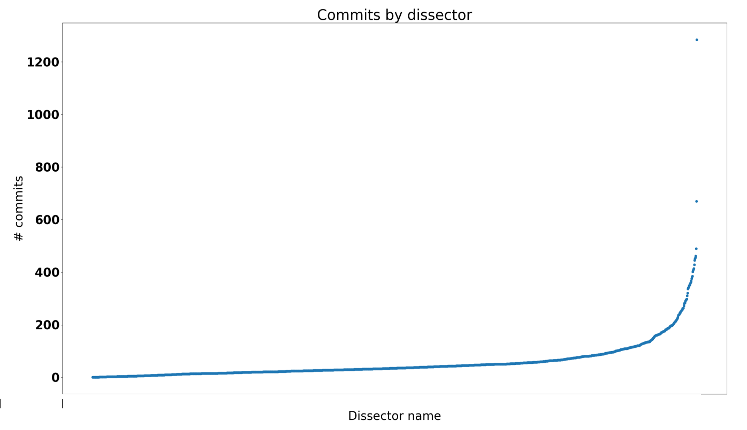
Commits per dissector?
packet-ieee80211.c
packet-tcp.c
packet-smb2.c
Notes:
Thanks to Gerald for importing full history so well when updating to different source control systems. First commit in current gitlab repo goes back to September 1998!
Need to keep in mind:
Age of dissector – lots of API churn, possibly protocol version churn
Complexity of dissector (more features to add)
Large dissectors could logically could split up into sub-protocols?
TCP is not *super* complicated but is so important its taps are consumed by multiple visualisations, sequence analysis / expert info, many preferences, custom re-assembly
Packet-smb.2 was worked on quite intensely both protocol updates/fixes and lots of maintenance (there since 2004). 14,000 lines, 10 commits by me (all maintenance). Dissector was written twice (first time without specs)…
Packet-tcp.c is always popular, 9,830 lines 8 commits by me (actual features). Custom reassembly, sequence analysis, etc
Packet-ieee80211.c should arguably have been split up. Has 55,397 lines! 35 changes by me, I think 2 were features, the rest bugfixes.
Size of commits is another metric. Personal developer preference, maybe careful/directed changes to popular protocols.
The point is that some dissectors are going to matter more to more users, but all dissectors matter(ed) to someone, they can serve as a good or bad example for someone to copy, and they provide a treasure trove of test data to refine checks to prevent similar bugs being introduced in the future.

Slide 19
Quality
Decode fields of interest
Notes:
Decode fields of interest
Bit-bit-bit decode vs high-level flow?
E.g. Complain about reserved bits set?
Show when malformed?
Trust de-facto implementation or aggressively mirror state-machine, check constraints and hold to spec?
Do you want to see issues implementations don’t notice, or only look for issues when implementation grumbles?
There is a danger of the author making dissector too specific to their own needs, e.g.,
Analyse w.r.t. one side of a link
Add their own local error codes to tapped information…
Filters work as expected – readable and labels/filters match spec
Readable but match wording of spec
First contribution idea: if you click on a field and are not sure what it means, look up spec and fix blurb.

Slide 20
Quality
Decode fields of interest
Clear summaries
Notes:
Useful summaries in columns (also show protocol before/after as appropriate?)
Even TCP gets out of the way when we are more interested in what it carries
PDCP example of preference saying which column info do you want to see (below, this, above?)

Slide 21
Quality
Decode fields of interest
Clear summaries
Stable
Notes:
Not crashing (array indices in-range, divide-by-zero, deep/infinite recursion, etc)
Memory leaks
Avoids infinite (or 2^32) loops
Not aware of any attempts to add malicious code to Wireshark

Slide 22
Quality
Decode fields of interest
Clear summaries
Stable
Maintainable
Notes:
Basic code health, readability, consistency (within reason).
Indentation can easily be matched.
Comments where needed
Use existing APIs where possible, and choose to be like other dissectors where reasonable
Captures available
Links to documentation
Doesn’t cause problems for other dissectors
Pollute namespace with symbols
Avoid recursion, or do it very carefully
Claim ports / proto-ids that should belong to other dissectors
Over-eager heuristics that claim everything…
Where appropriate, use of available/stable/maintained libraries

Slide 23
Stages of Development
Initial Development
Notes:
Just what you do locally before the changed might uploaded to gitlab

Slide 24
Stages of Development
Initial Development
GitLab Merge request

Slide 25
Stages of Development
Initial Development
GitLab Merge request
Post-Merge
Notes:
Not yet in release – what else happens that can improve the dissector

Slide 26
Initial Development
Need specification & captures
Notes:
Specifications vary a lot. Some require group membership and/or payment
ready)
Have sometimes done without one or other
No captures yet but want to put a stake in the ground
RealPlayer. Something provocatively bad led to developer showing me spec..
Some written in bits and bytes (like ‘Packet Diagram’ from Layout Preferences)
Plus a description of each field
Some are harder work to understand.
Some described using higher-level language e.g.
ASN.1 (for BER/PER based protocols)
IDL (various Interface Description Languages exist). There is a perl generator that I haven’t gotten involved with
RPC (other 2 have auto-generators). RFC 1831 and RFC 1832 (XDR: External Data Representation)
gRPC and/or protobuf are just configured with .proto files and preferences – no development (unless you count getting a profile that you might share with your team)

Slide 27
Initial Development
Need specification & captures
Read docs vs copy examples?
Notes:
Might or might not be typical, but personally I:
Looked at code to get feel
Dissected some data with mixed results
Read the docs and got a lot out of them
Copied mine and others’ dissectors for a long time
Re-read docs with more context and filled in some holes
Lots of good stuff, changed some inaccuracies that might undermine people’s confidence in what they say
Grepped / RE’d for some Don’ts, and undid them
So not always followed closely!
Important info in docs is about baseline of features that are available on all platforms and supported library versions.

Slide 28
Initial Development
Need specification & captures
Read docs vs copy examples?
Build with own compiler
Notes:
Before even build, may see “intellisense” checks that use a different compiler?
Will find a lot of issues, but our C APIs are quite permissive.
Some compilers complain about more than others…
Data-flow tracking, unsound casting, etc

Slide 29
Initial Development
Need specification & captures
Read docs vs copy examples?
Build with own compiler
Test against own/local captures
Notes:
The more the better.
If a protocol is new:
Captures may only exercise a subset of protocol/dissector
Protocol could later settle down and expand a lot
Backward-compatibility might happen later
If running Windows, may not notice some asserted warnings/errors written to console
Can run as an ASAN build or under valgrind to see non-fatal errors.

Slide 30
Initial Development
Need specification & captures
Read docs vs copy examples?
Build with own compiler
Test against own/local captures
Commit-hook checks (optional)
Notes:
Optional though highly recommended (especially if submitting MR)
Requires perl to be installed (a dependency we have worked to get rid of..) Lots of sanity checks, forbidden APIs etc. Checks commit-msg itself (line length)
Errors will stop commit, warnings will appear in console then often hidden by editor for commit message.
Question: is there a git hook option for this, or should we make user press Enter for warnings-but-no-errors?
Running locally will avoid doomed gitlab pipelines
Also attempts to validate diameter xml files

Slide 31
Initial Development
Need specification & captures
Read docs vs copy examples?
Build with own compiler
Test against own/local captures
Commit-hook checks (optional)
Private code may stop here…
Notes:
Not all changes are appropriate for submitting to project, but keeping changes private that could be upstream means that the changes won’t get updated, and users will be stuck with old Wireshark version…

Slide 32
GitLab Merge Request
Change rebased onto master
Notes:
Must cleanly apply on top of development tip
If doesn’t, can usually rebase in gitlab web gui

Slide 33
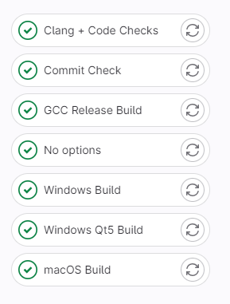
GitLab Merge Request
Change rebased onto master
Pipelines run
Commit-hook checks
Build on all platforms
Run tests
Static Analysis
Notes:
Commit-hook checks
Can’t run on every possible compiler/platform, but try to get good coverage
Does include clang-
Suite of tests using pytest
Many not relevant to dissectors:
Some dissector ones
Checking scripts
cppcheck
Some of the python scripts I’ve written

Slide 34
GitLab Merge Request
Change rebased onto master
Pipelines run
Commit-hook checks
Build on all platforms
Run tests
Static Analysis
Manual review process
Iterate
Notes:
Obvious/common bugs (loops, scary array indexing)
Using the available APIs efficiently where appropriate
Steer people away from adding more plugins to tree
Sometimes can see approach is sound, but don’t check every detail
Tagging someone who has worked on dissector before can be useful
Sometimes merging is the best way to get the attention of whoever will care most
Whoever responds often will be the only reviewer…. Flagging a warning from pipeline can be a good way to let developer know someone is there

Slide 35
GitLab Merge Request
Change rebased onto master
Pipelines run
Commit-hook checks
Build on all platforms
Run tests
Static Analysis
Manual review process
Iterate
Merge onto master branch
Notes:
All review issues resolved so merge (only core devs can do). Pipeline runs again?

Slide 36
Post-Merge
Fuzzing
Notes:
Fuzz effectively on packet data, not preference settings or file format? Have separate slide about this..

Slide 37
Post-Merge
Fuzzing
Bug reports / enhancements
Notes:
Also protocol version churn, specification interpretation

Slide 38
Post-Merge
Fuzzing
Bug reports / enhancements
General maintenance
Notes:
Update with new APIs, etc
Not many sweeping changes recently, APIs have settled down lately…

Slide 39
Post-Merge
Fuzzing
Bug reports / enhancements
General maintenance
Ad-hoc checks
Notes:
Someone finds an anti-pattern, and sweeps codebase fixing other instances..

Slide 40
Post-Merge
Fuzzing
Bug reports / enhancements
General maintenance
Ad-hoc checks
Join a release branch
Notes:
Changes lives in master until next time a release-branch is cut. Next branch is ???

Slide 41
General Checks
Compilers
Static Analyzers
Protocol Documentation
Spelling errors / typos
Unnecessary #includes?
Non-static/unused code
Forbidden APIs
Notes:
Not much to say about these – am going to go through these general checks

Slide 42
Compiler Checks
Different compilers flag different things
Notes:
Code is the better for being clean in several different compilers. New versions of compilers bring in new checks. Generally someone will try out new versions of gcc or Microsoft Visual Studio before pipelines support them.

Slide 43
Compiler Checks
Different compilers flag different things
Use –Werror with as many warnings as can
Notes:
There is even one case where a perl script will warn about changes that would likely trip up –Wshadow even if we can’t enable it.

Slide 44
Compiler Checks
Different compilers flag different things
Use –Werror with as many warnings as can
Build without optional packages
Notes:
Wireshark has a list of required packages, and others that are optional. Code needs to conditionally compile for the absence/presence of several libraries. Sometimes simpler to make a library required.

Slide 45
Compiler Checks
Different compilers flag different things
Use –Werror with as many warnings as can
Build without optional packages
Verify printf-style format vs args
Notes:
Unexpected behaviour if don’t get format specifiers vs args right (can include crashing). I don’t know if e.g., VS supports these…?

Slide 46
Compiler Checks
Declare
Notes:
Internal APIs are very good at including directives so that checks are done at compile-time. Scanned dissectors – only place directives were needed were mine…

Slide 47
Compiler Checks
Declare
Call
Notes:
2nd line looks ahead to a later slide.

Slide 48
Static Analyzers
Redundant assignments & tests
Apparent memory leaks
Notes:
Only useful when someone looks at the output. They all tend to pick on these obvious things
Assign variables to 0 then always overwrite
Can get in way of compiler flow analysis (i.e. assigned on every path)
Classic offset advancement
Useless tests
Already inside a guard and checking same (or opposite) again

Slide 49
Static Analyzers
Redundant assignments & tests
Apparent memory leaks
clang & cppcheck run in pipeline
Notes:
Both free!

Slide 50
Static Analyzers
Redundant assignments & tests
Apparent memory leaks
clang & cppcheck run in pipeline
Coverity is security-focused
Notes:
Worried about input validation
Tvb asserts often take care of this
Hasn’t been taught to relax about our scoped memory – so assumes leaks
Really good at tracking previous decisions / state of variables

Slide 51
Static Analyzers
Redundant assignments & tests
Apparent memory leaks
clang & cppcheck run in pipeline
Coverity is security-focused
PVS-Studio found lots of issues
Notes:
found lots of good stuff
A couple of blog posts that flagged interesting issues:
Doesn’t appear to be so available for open source projects now

Slide 52
Static Analyzers
Redundant assignments & tests
Apparent memory leaks
clang & cppcheck run in pipeline
Coverity is security-focused
PVS-Studio found lots of issues
Visual Studio Code Analyzer
Notes:
Recently started running again.
Issues with current output (doesn’t show which file its reporting), but appears to be flagging format specifiers (fussily) and suspected memory leaks

Slide 53
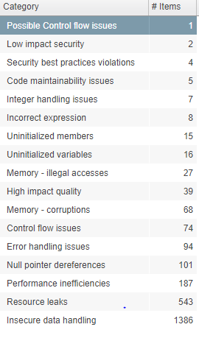
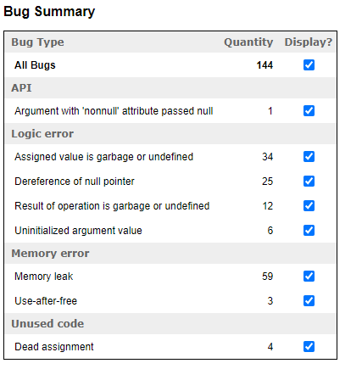
Static Analyzers
Notes:
These HTML reports are from running cppcheck and clang in pipeline

Slide 54
Protocol Documentation
Important!
Notes:
Difficult to fix anything but the most obvious self-contained bugs without some kind of protocol specification.

Slide 55
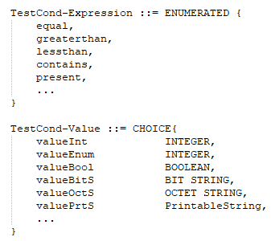
Protocol Documentation
Important!
‘Packet Diagram’ vs ASN.1/IDL/RPC/protobuf schemas
Notes:
Different styles. Note that when the dissector is generated using some tool, we need to fix issues in the input files, not the generated files. And probably not in the schema files – need to report that to specification publisher.

Slide 56
Protocol Documentation
Important!
‘Packet Diagram’ vs ASN.1/IDL/RPC/protobuf schemas
Access requires membership/payment?
Notes:
Tedious when can’t easily get access to documentation..

Slide 57
Protocol Documentation
Important!
‘Packet Diagram’ vs ASN.1/IDL/RPC/protobuf schemas
Access requires membership/payment?
Web-URLs tend to rot…
Notes:
Companies / consortiums renaming or disappearing. Website re-organisations. Sometimes wayback machine is best option.

Slide 58
Protocol Documentation
Important!
‘Packet Diagram’ vs ASN.1/IDL/RPC/protobuf schemas
Access requires membership/payment?
Web-URLs tend to rot…
tools/check_dissector_urls.py to find and test URLs

Slide 59
Protocol Documentation
(all dissectors)
Notes:
Discussion when first added led to policies – preferring https, and standard way to refer to RFCs (though don’t appear to be following it here!).
Had help getting it down from 35 minutes to ~2 minutes
Sometimes searchable terms are more useful than an actual web link.

Slide 60
Spelling
tools/check_spelling.py uses pyspellchecker + dictionary file (~1800 words)
Notes:
Some developers don’t see spelling mistakes, and that’s fine.
Lintian already exists, and some spelling errors have been found in the past using it.
Over 1,100 spelling fixes done for dissectors, but other commits done for other folders
Sometimes same error fixed multiple times
Sometimes variable/comment had same wrong misspelling – probably counted some of those
Some of the commits I looked at had also non-dissector spelling fixes…
did separate commits for other parts of the Wireshark source tree.

Slide 61
Spelling
tools/check_spelling.py uses pyspellchecker + dictionary file (~1800 words)
Only looks at literal strings (might be seen by users)
Notes:
Even these might not be easy to fix, e.g.
A misspelt preference that has been there for a long time..
A string that was spelled wrong in the spec (particularly true of generated dissectors)

Slide 62
Spelling
tools/check_spelling.py uses pyspellchecker + dictionary file (~1800 words)
Only looks at literal strings (might be seen by users)
MultipleWordRunOns in_various_ways sometimesnogapwhatsoever and filters.are.like-this
Notes:
It turns out that almost any 2-letter combination is a word in my dictionary, so difficult to reliably break down words that run on…

Slide 63
Spelling
tools/check_spelling.py uses pyspellchecker + dictionary file (~1800 words)
Only looks at literal strings (might be seen by users)
MultipleWordRunOns in_various_ways sometimesnogapwhatsoever and filters.are.like-this
Shows most popular unknowns
Notes:
It’ll show up to the top 100 unknown words using collections.Counter. Useful for showing good candidates for cutting down the output to scroll through…

Slide 64
Spelling
Notes:
‘nan’ was added to the dictionary because it appears in a call to “proto_register_protocol()”

Slide 65
Unnecessary #includes
tools/delete_includes.py is a blunt tool
Notes:
is rather crude / brute-force. Wrote in 2014, and deleted a few hundred includes then, and provoked discussion about what we should recommend
Wrote it for work – was hoping to speed up big build, Deleted c30,000+ of #includes – but didn’t help clean build time.
Runs in simple-minded way:
Try a build to make sure we have one!
For each file we are testing:
Make sure it is part of the build (by prexing something uncompilable)
Basically, delete each #include in turn and see if it still builds.
If it builds, didn’t need deleted line!
With exceptions (a list), plus preserve self-includes
Recently revived (was my first-ever python program). Has provoked Nicolas to check that files include what they need. Whereas delete_includes.py is about not including what you don’t need.
Also: clang-include-fixer (tries to add missing includes to a c/cpp file – one at a time)
Maybe delete_includes.py time will come again once header files are self-including….

Slide 66
Unnecessary #includes
tools/delete_includes.py is a blunt tool
Goals:
Declutter dissector files
Faster incremental rebuild
Set good examples
Notes:
Have run on other parts of the Wireshark tree as well as another work project.

Slide 67
Unnecessary #includes
tools/delete_includes.py is a blunt tool
Goals:
Declutter dissector files
Faster incremental rebuild
Set good examples
Has provoked some discussion ☺
Notes:
Include what you use, plus other tools utilising clang also exist.

Slide 68
Statics
Avoid polluting namespace, accidental merging, unused code
Notes:
Another tool was created.. Uses ‘nm’ on object files, so build has to be up-to-date.
Tools needs build folder so that it can find object files to run nm on them (limiting platforms it can run on?)
Note that dissectors on right includes packet-a itself, but it won’t tell you whether it refers to it…
If no external refs, make static
If no callers, build will fail
Warn (rather than error) only if appears to be declared in header file.
Very few of these functions are likely to be called, ever
Some are intended for private dissectors to call
Currently 273 symbols reported (all declared in header files…)
Get ‘called’ by finding ‘U’ entries in dissector .o files
+ ui folder
For each file we’re checking:
‘defined’ labelled with ‘T’ or ‘D’
Local defined would be ‘t’ or ‘d’
If ‘defined’ and not ‘called’, and not mentioned in expected header files:
Could be static (or deleted) ?
Not on Windows (objdump.exe output formats are different)
Takes around 11s to run
455 symbols made static or eliminated.

Slide 69
Statics
Avoid polluting namespace, accidental merging, unused code
tools/check_static.py

Slide 70
Statics
Avoid polluting namespace, accidental merging, unused code
tools/check_static.py
packet-a.c
Define: A

Slide 71
Statics
Avoid polluting namespace, accidental merging, unused code
tools/check_static.py
packet-a.c
Define: A
Defines: A (‘T’ or ‘D’)
packet-a.o

Slide 72
Statics
Avoid polluting namespace, accidental merging, unused code
tools/check_static.py
packet-a.h
Declares: A?
packet-a.c
Define: A
Defines: A (‘T’ or ‘D’)
packet-a.o

Slide 73
Statics
Avoid polluting namespace, accidental merging, unused code
tools/check_static.py
packet-a.h
packet-*.o
ui/*.o
Declares: A?
packet-a.c
Define: A
Refers: A (‘U’) ?
Defines: A (‘T’ or ‘D’)
packet-a.o

Slide 74
Dissector-specific Checks
Dissector model

Slide 75
Dissector-specific Checks
Dissector model
Basic hf usage

Slide 76
Dissector-specific Checks
Dissector model
Basic hf usage
value_string/range_string

Slide 77
Dissector-specific Checks
Dissector model
Basic hf usage
value_string/range_string
true_false_string

Slide 78
Dissector-specific Checks
Dissector model
Basic hf usage
value_string/range_string
true_false_string
tests (pytest)

Slide 79
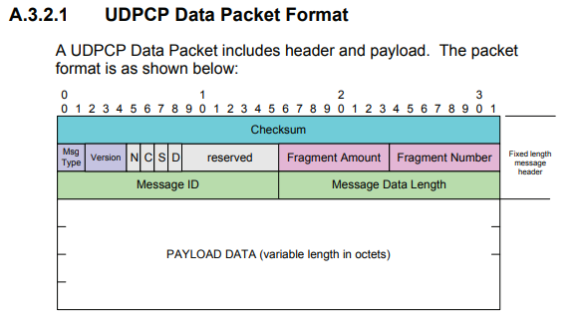
Dissector Intro
0. Fields in protocol specification

Slide 80
Dissector Intro
1. Declare hf entries

Slide 81
Dissector Intro
1. Declare hf entries
2. Define hf entries

Slide 82
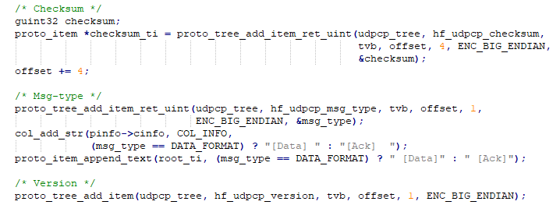
Dissector Intro
3. Add hf items to tree using proto_tree_add..() functions

Slide 83
Dissector Intro

Slide 84
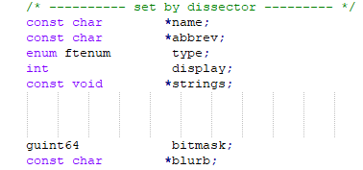
hf in detail
Label
Display Filter
FT_<type>
BASE_DEC, etc or number of bits
NULL or VALS() or RVALS() or TFS()
Mask identifies which bits are in use
Long help text (displayed bottom left in toolbar)

Slide 85
Basic hf usage
Declared but not defined?

Slide 86
Basic hf usage
Declared but not defined?
Defined but not used?

Slide 87
Basic hf usage
Declared but not defined?
Defined but not used?
Filter should start with protocol name

Slide 88
Basic hf usage
Declared but not defined?
Defined but not used?
Filter should start with protocol name
Sanity-check labels

Slide 89
Basic hf usage
Declared but not defined?
Defined but not used?
Filter should start with protocol name
Sanity-check labels
Blurb should not (exactly) match label

Slide 90
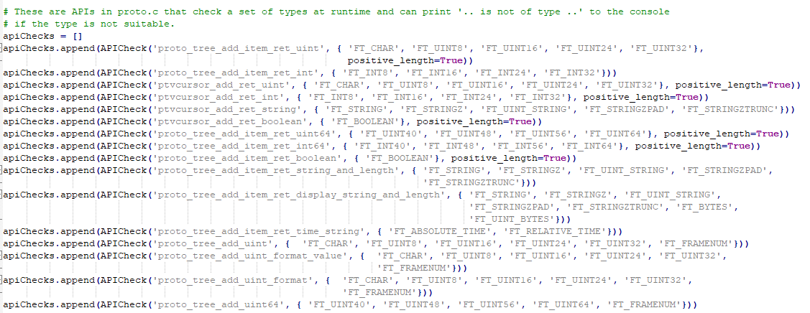
API calls vs hf
+ around 20 more APIs

Slide 91
Length of API calls
API call:

Slide 92
Length of API calls
API call:
hf_myprot_msgType
FT_UINT8
VALS(msgType_vals)

Slide 93
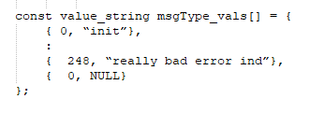
Length of API calls
API call:
hf_myprot_msgType
FT_UINT8
VALS(msgType_vals)

Slide 94
Length of API calls
API call:
hf_myprot_msgType
FT_UINT8
VALS(msgType_vals)
Data at offset:

Slide 95
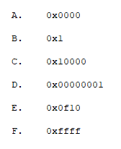
Mask field
For a FT_UINT16, what about?

Slide 96
add_bitmask APIs

Slide 97
add_bitmask APIs

Slide 98
add_bitmask APIs

Slide 99
Copy/paste errors
Consecutive hf items defined with same display filter?

Slide 100
Copy/paste errors
Consecutive hf items defined with same display filter?
Consecutive labels and masks are often OK..

Slide 101
Copy/paste errors
Consecutive hf items defined with same display filter?
Consecutive labels and masks are often OK..

Slide 102
Copy/paste errors
Label vs last part of filter?

Slide 103
Copy/paste errors
Label vs last part of filter?
Show mismatches if > 90% do match

Slide 104
Copy/paste errors
Label vs last part of filter?
Show mismatches if > 90% do match

Slide 105
value_string
hf definition has e.g., VALS(msg_type_vals)

Slide 106
value_string
hf definition has e.g., VALS(msg_type_vals)

Slide 107
value_string
Check for conflicts (same value, different strings)
Check for NULL termination

Slide 108
range_string
hf definition has e.g., RVALS(nickname_strings)

Slide 109
range_string
hf definition has e.g., RVALS(nickname_strings)
List of min/max pairs

Slide 110
range_string
hf definition has e.g., RVALS(nickname_strings)
List of min/max pairs
Checked in order – stop on first match

Slide 111
range_string
hf definition has e.g., RVALS(nickname_strings)
List of min/max pairs
Checked in order – stop on first match

Slide 112
Looking up value strings
Expect a format specifier in unknown…

Slide 113
Looking up value strings
Expect a format specifier in unknown…
…but not for _const variants

Slide 114
Looking up value strings
Expect a format specifier in unknown…
…but not for _const variants
What happens if we get it wrong?

Slide 115
true_false_string
hf definition has e.g.,

Slide 116
true_false_string
hf definition has e.g.,
epan/tfs.c has some common definitions

Slide 117
true_false_string
hf definition has e.g.,
epan/tfs.c has some common definitions
tools/check_tfs.py looks for dissectors not sharing

Slide 118
true_false_string
hf definition has e.g.,
epan/tfs.c has some common definitions
tools/check_tfs.py looks for dissectors not sharing
Find new common candidates?

Slide 119
true_false_string
Some value_strings could/should be common tfs?

Slide 120
true_false_string
Some value_strings could/should be common tfs?
Only if strings match exactly, AND
Field is only 1 bit wide

Slide 121
true_false_string
Some value_strings could/should be common tfs?
Only if strings match exactly, AND
Field is only 1 bit wide

Slide 122
fuzzing
tools/fuzz-test.sh for fuzzing captures locally

Slide 123
fuzzing
tools/fuzz-test.sh for fuzzing captures locally
Oss-fuzz (google)

Slide 124
fuzzing
tools/fuzz-test.sh for fuzzing captures locally
Oss-fuzz (google)
Checks out Wireshark + repo with captures

Slide 125
fuzzing
tools/fuzz-test.sh for fuzzing captures locally
Oss-fuzz (google)
Checks out Wireshark + repo with captures
Builds Wireshark + tools/oss-fuzzshark

Slide 126
fuzzing
tools/fuzz-test.sh for fuzzing captures locally
Oss-fuzz (google)
Checks out Wireshark + repo with captures
Builds Wireshark + tools/oss-fuzzshark
Tools to triage/reproduce/log as Gitlab issue

Slide 127
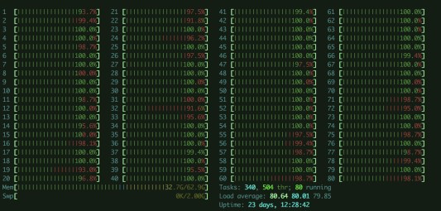
fuzzing – creating a corpus

Slide 128
tests (pytest)
Some dissector-specific tests using tshark

Slide 129
tests (pytest)
Some dissector-specific tests using tshark
tshark –G values catches certain errors

Slide 130
tests (pytest)
Some dissector-specific tests using tshark
tshark –G values catches certain errors
There isn’t really a framework for isolating a dissector..

Slide 131
checking a dissector
tools/check*.py have some common command-line options

Slide 132
checking a dissector
tools/check*.py have some common command-line options
Notes:
Some of the other scripts have versions of these options too

Slide 133
checking a dissector
tools/check*.py have some common command-line options
Need to avoid ‘fixing’ generated files

Slide 134
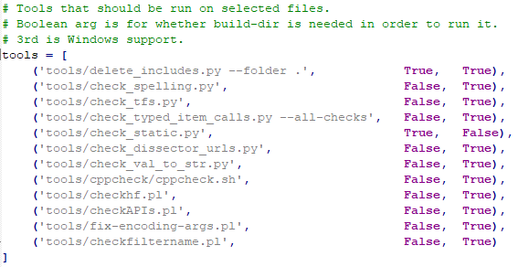
checking a dissector
tools/check_dissector.py is a wrapper
Notes:
All apart from check_static will run under Windows
Delete_includes will only run if –build-folder is given

Slide 135
Observations
Related checks sometimes separated by stage/tool

Slide 136
Observations
Related checks sometimes separated by stage/tool
Should look harder to make use of external tools

Slide 137
Observations
Related checks sometimes separated by stage/tool
Should look harder to make use of external tools
Simple RE matching will miss things

Slide 138
Observations
Related checks sometimes separated by stage/tool
Should look harder to make use of external tools
Simple RE matching will miss things
Should push checks to earliest stage possible
Notes:
Have you noticed bugs in dissectors? What have you seen?

Slide 139
Observations
Related checks sometimes separated by stage/tool
Should look harder to make use of external tools
Simple RE matching will miss things
Should push checks to earliest stage possible
Need to balance strictness with easy of submitting
Notes:
Have you noticed bugs in dissectors? What have you seen?

Slide 140
Thank You!

