Slide 1
Talk To Your Packets:
AI-Powered Natural Language Interaction with Packet Captures
John Capobianco
@john_capobianco

Slide 2

Let me introduce myself
25 Years in IT
Started network automation in 2014
Directly led to adoption of AI in 2022
Head of DevRel at Selector AI
And these are my socials:
  @john_capobianco (X)
  @automateyournetwork (Bsky)
  john-capobianco-644a1515 (LinkedIn)
  automateyournetwork.ca

Slide 3
Not to distract you during the presentation; but please try
Packet Copilot: packetcopilot.selector.ai
And ask yourself – how is this done?

Slide 4
What is Retrieval Augmented Generation?
The Stages of AI
  1.0 - GUI / API
  1.5 - RAG
  2.0 - Agents
Retrieval Augmented Generation
  6 Step Process
  Embeddings (Vectors)
  Storage
  Retrieval
RAG-Fusion
  Multi-query
  Reciprocal Ranking
RAPTOR​
  Spine-Leaf ?​
  ​
GraphRAG​
  Knowledge Graphs​
  ​
TAG​
  Tables​
  ​
RAFT​
  Fine-Tuning​
Agents using RAG ​
  Agentic RAG​
  Tool Selection

Slide 5
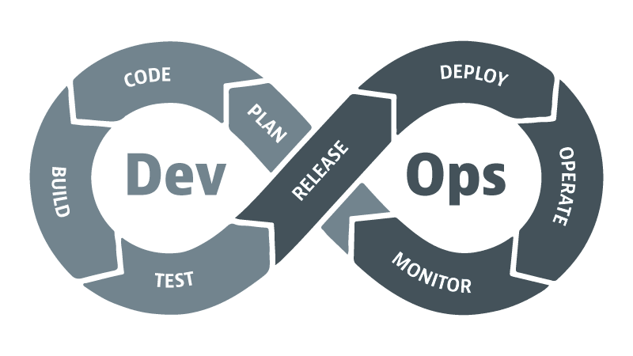
Evolution of Operations
Traditional Operations
    Syslog, SNMP
    Manual effort
    Reactive
DevOps
    Agile
    CI/CD
    Break down silos
NetDevOps
    Infrastructure as Code
    Automation
AIOps
  Augmented with AI
  Closed Loop
VibeOps (?)
  MCP
  Agents

Slide 6
AI 1.0: GUI / API
The beginning of modern AI integration into workflows. Interfaces were built around graphical user interfaces (GUI) and REST APIs. Systems were reactive, rule-based, and required precise inputs.
Characteristics:
  Manual interactions via UI
  Predefined API endpoints
  No contextual understanding
  Automation limited to basic scripting

Slide 7
AI 1.5: Retrieval Augmented Generation (RAG)
A leap in capability with large language models able to retrieve and reason over external data. Systems began to offer contextual responses grounded in current or proprietary knowledge.
Characteristics:
  Combines LLMs with external data sources
  Supports context-aware Q&A
  Introduces knowledge grounding
  Still linear, not autonomous

Slide 8
AI 2.0: AI Agents
The emergence of autonomous, goal-driven agents capable of planning, reasoning, and taking actions across multiple tools. Systems evolve from stateless prompts to stateful workflows.
Characteristics:
  Task orchestration and tool use
  Memory and planning
  Multi-step reasoning
  Autonomous execution across APIs, files, and platforms

Slide 9
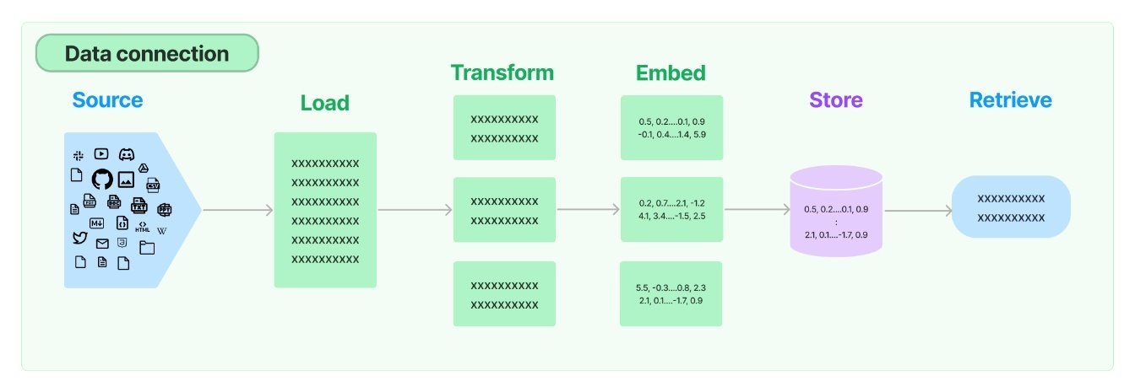
6 Steps of RAG using LangChain

Slide 10
Packet Captures (.pcap; .pcapng)
As of today you cannot upload .pcap / .pcapng to Large Lanauge Models (LLMs) directly; (yet)
There are manual processes of exporting your capture to text and then pasting the text into the LLM GUI
Using RAG we can automate this process and provide users the ability to simply upload their capture and start 'talking' to it.
A pre-step, or a 7th intermediate step, in the RAG process is required: transforming the .pcap to JavaScript Object Notation (JSON) allowing us to use a JSONLoader to load the transformed data.
Another good idea is to sanitize / cleanse / cleanup any metadata that is unnecessary such as large HEX fields of data (tcp.data or udp.data fields) before splitting and embedding the data.

Slide 11
Source
The source of the external knowledge you want to augmented the generation of output.
High level categories:
  Webpages
  PDFs
  Cloud Providers
  Social Platforms
  Messaging Services
  Productivity Tools
  Common File Types
    CSV
    Directory of files
    Unstructured files
    JSON <==== there is no .pcap source; but there is a JSON source
    HTML

Slide 12
Load
Once you have a source you need to find the appropriate loader; note there is no .pcap loaded but there is a JSONLoader
Sample code to load a JSON file:
from langchain_community.document_loaders import JSONLoader
file_path='./sample.json'
loader = JSONLoader(
file_path=file_path,
jq_schema='.quiz',
text_content=False)
docs = loader.load()
print(docs[0].page_content[:100])
print(docs[0].metadata)
For all loaders: ​
Document loaders | 🦜️🔗 LangChain​
document_loaders — 🦜🔗 LangChain documentation

Slide 13
Transform (Split)
A semantic splitter breaks text into chunks based on meaning, not just size or structure. It uses LLMs or embeddings to find natural boundaries—like a shift in topic, tone, or idea—rather than blindly splitting by paragraphs, headers, or token limits.
📘 Example: Network Engineering Manual
Imagine you're using RAG on a 50-page Cisco IOS XE config guide.
Naive splitter: Splits every 500 tokens. This might:
    Split a show ip interface brief explanation halfway.
    Mix unrelated topics like BGP and EIGRP in the same chunk.
Semantic splitter: Analyzes where the concept changes and chunks accordingly:
    One chunk for show ip interface brief
    Another for configure static routing
    Another for EIGRP authentication
  This ensures each chunk is coherent, self-contained, and relevant to a single question.

Slide 14
Embed (Vectors)
Embedding models transform human language into a format that machines can understand and compare with speed and accuracy.
These models take text as input and produce a fixed-length array of numbers, a numerical fingerprint of the text's semantic meaning.
Embeddings allow search system to find relevant documents not just based on keyword matches, but on semantic understanding.
Input: "How do I configure BGP authentication?"
Output: [0.12, -0.87, 0.45, ..., 0.33] ← fixed-length vector
Similar vectors → semantically similar content

Slide 15
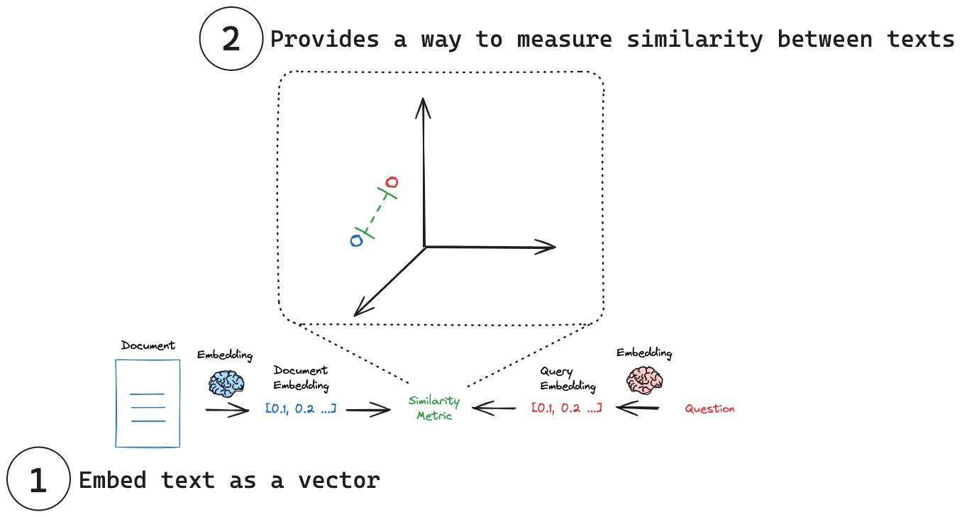
Embedding models | 🦜️🔗 LangChain

Slide 16
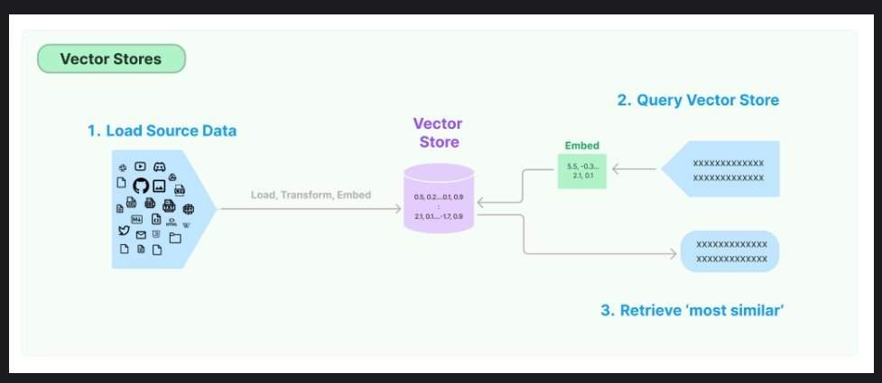
Store
Now that we have lists of floating point numbers, the vectors, we need to store them either in memory or in a database (or both). This database is optimized for storing and searching embeddings (numerical vectors). Enabling fast similarity search to retrieve relevant documents based on semantic meaning.
ChromaDB, FAISS, Weaviate, Pinecone, Elastic, Qdrant, Milvus

Slide 17
Retrieve
Finally the Large Language Model (LLM) gets involved in the process and the prompt is transformed into vectors and a similarity search is performed between the prompt and the vector store returning the closest vectors to augment the generation of output.

Slide 18
How "good" is it?

Slide 19
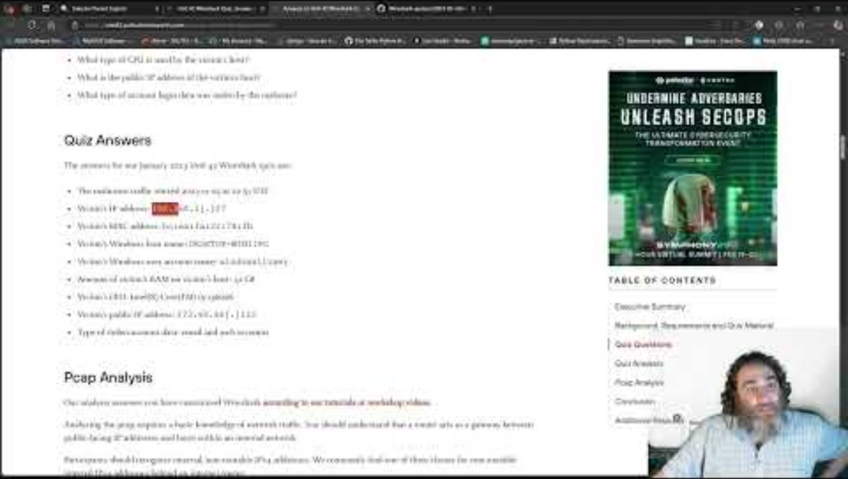
Packet Copilot vs Unit 42's Quiz

Slide 20
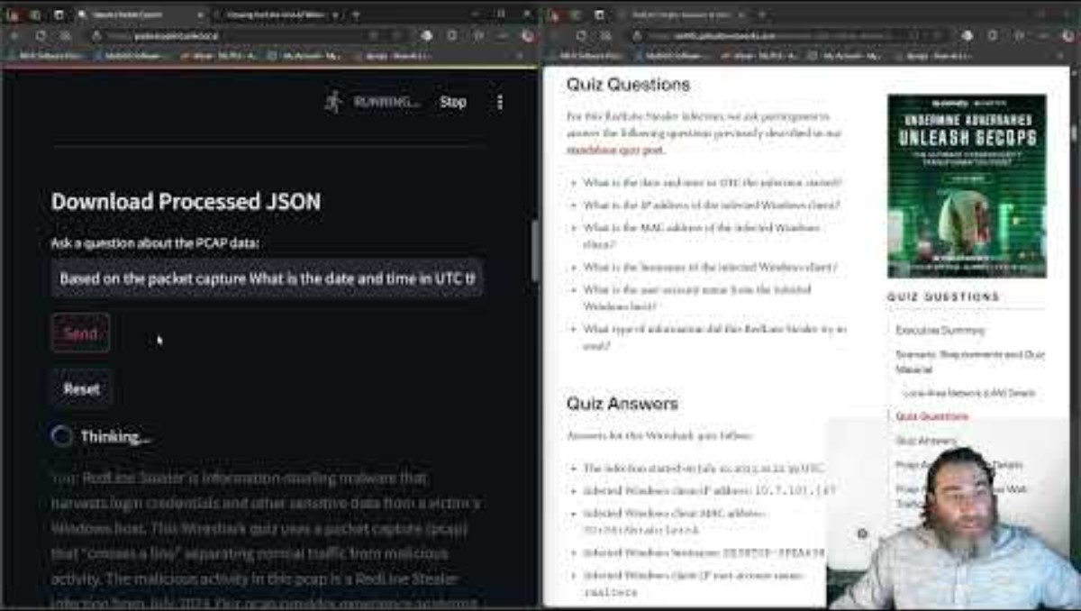
Packet Copilot vs Another Unit 42's Quiz

Slide 21
Results:
Not quite perfect – 9 / 10 correct
* Instantaneous using real PCAP data
* 10th question correct with 'better' prompt
How many humans could do this with Wireshark?
How long would it take?

Slide 22
Multi-Query

Slide 23
People ask stupid questions!
Can we take the users original question and derive +n number of similar questions
Similar or different in:
  Tone
  Sentiment
  Word selection
  Sophistication
  Technical accuracy
We can use AI to generate additional, similar, prompts to help AI generate the best possible answer to the original prompt

Slide 24
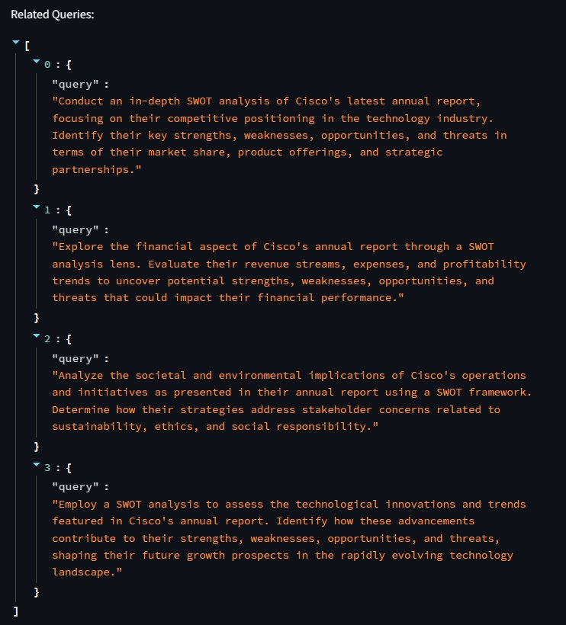

Multi-Query

Slide 25
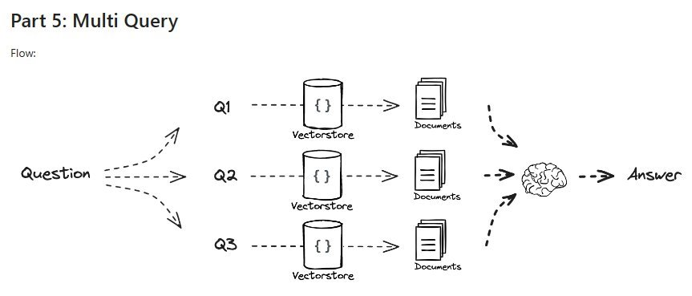
Multi-Query
rag-from-scratch/rag_from_scratch_5_to_9.ipynb at main · langchain-ai/rag-from-scratch · GitHub

Slide 26
RAG Fusion

Slide 27
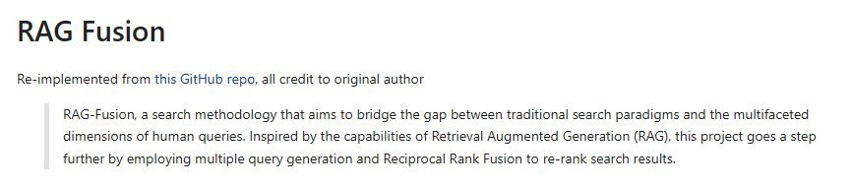
Reciprocal Re-Ranking (Fusion)
langchain/cookbook/rag_fusion.ipynb at master · langchain-ai/langchain · GitHub​

Slide 28
Sythnetic Answers
Going a step further we can use reciprocal ranking and other methods to evaluate and rank the 'best' answers
We can take 'all' answers and synthesize a 'best' answer
We can round-robin against multi-LLM to get different 'perspectives' and generations; and synthesize a multi-LLM council of answers
We can bounce the initial answers from all LLMs against all other LLMs and come to a consensus of the 'best' answer (and throw away outlying hallucinations

Slide 29
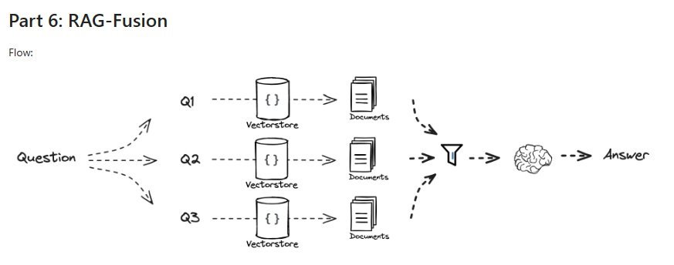
Reciprocal Re-Ranking (Fusion)
rag-from-scratch/rag_from_scratch_5_to_9.ipynb at main · langchain-ai/rag-from-scratch · GitHub

Slide 30
Recursive Abstractive Processing for Tree-Organized Retrieval: RAPTOR

Slide 31
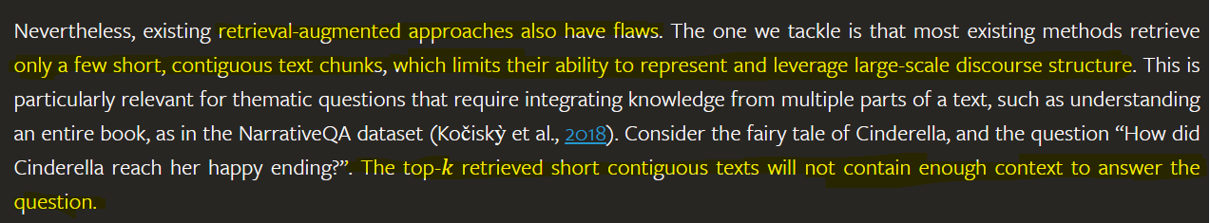
Drawbacks of basic RAG
RAPTOR: Recursive Abstractive Processing for Tree-Organized Retrieval (arxiv.org)

Slide 32
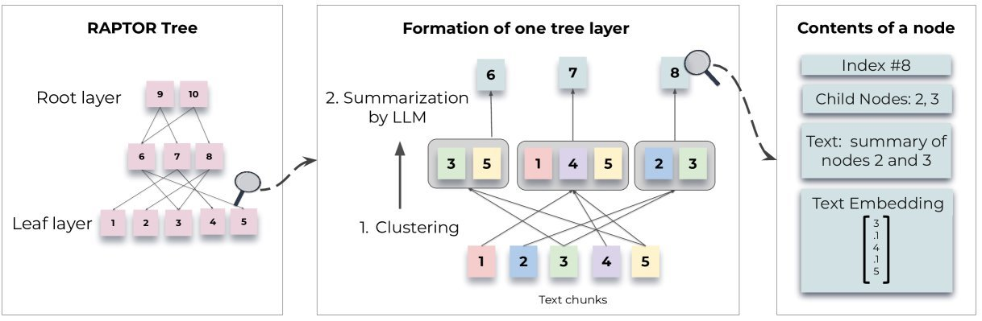
RAPTOR: Remind you of anything? Like a spine-leaf data center
RAPTOR: Recursive Abstractive Processing for Tree-Organized Retrieval (arxiv.org)

Slide 33
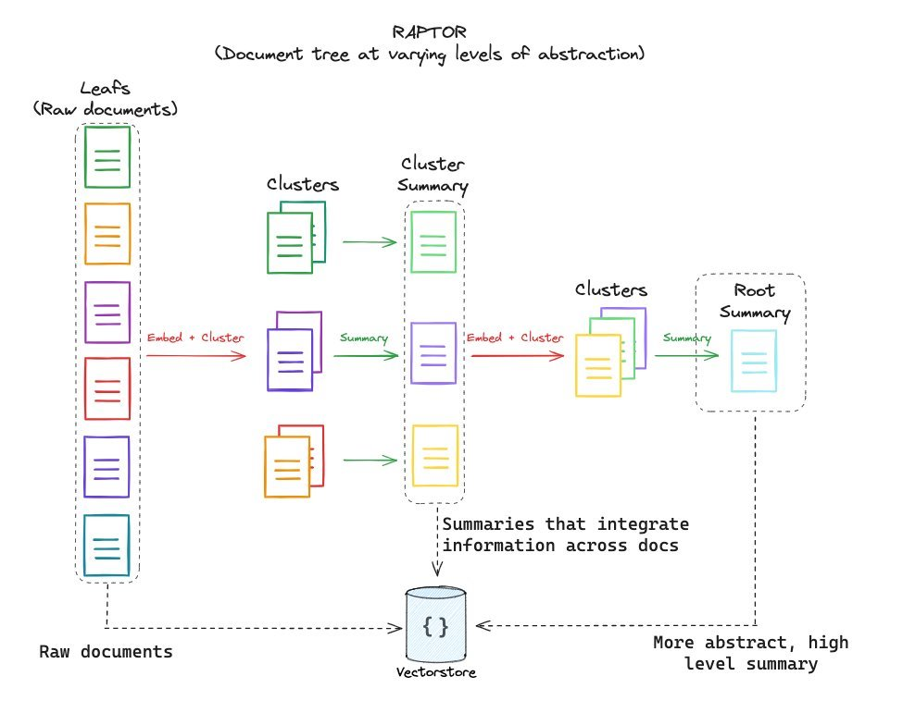
RAPTOR: Remind you of anything? Like a spine-leaf data center
langchain/cookbook/RAPTOR.ipynb at master · langchain-ai/langchain · GitHub

Slide 34
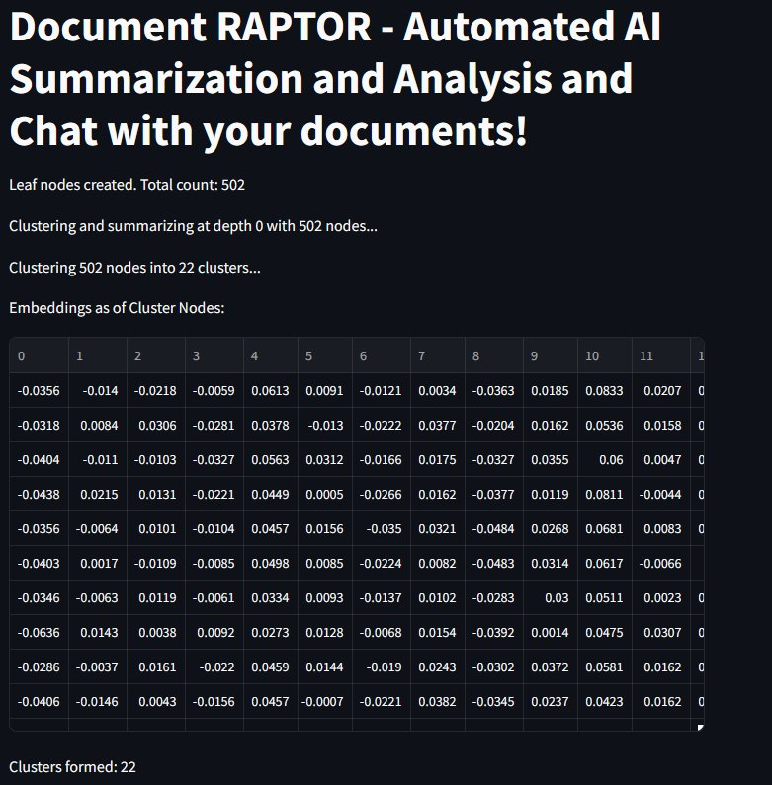
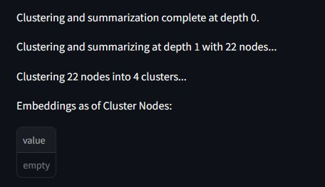
RAPTOR: Remind you of anything? Like a spine-leaf data center
5
LEAF NODEs
22 SPINES
4 SPINES
ROOT

Slide 35
GraphRAG

Slide 36
Knowledge Graphs
Going a step further we can use reciprocal ranking and other methods to evaluate and rank the 'best' answers
We can take 'all' answers and synthesize a 'best' answer
We can round-robin against multi-LLM to get different 'perspectives' and generations; and synthesize a multi-LLM council of answers
We can bounce the initial answers from all LLMs against all other LLMs and come to a consensus of the 'best' answer (and throw away outlying hallucinations

Slide 37
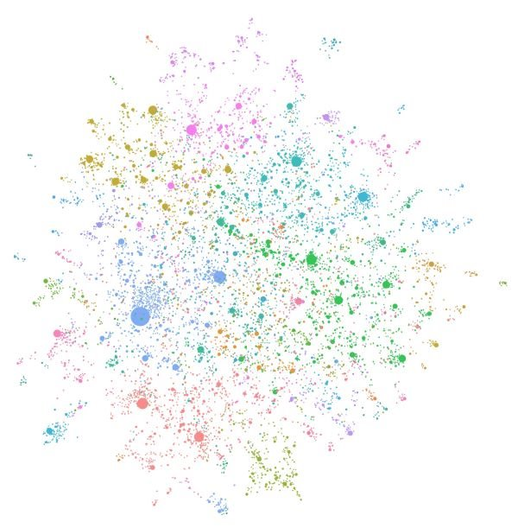
Welcome - GraphRAG

Slide 38
** WARNING **

Slide 39
Please be careful with GraphRAG approaches
As you can imagine these graphs are huge and require a lot of computational and GPU power.
I abandoned my first attempt at GraphRAG after the job / bill reached about $65 – and it wasn't even close to being finished
Local models (LLMs) via tools like Ollama can ease the costs but they will still take substantial amount of time to generate locally unless you have serious GPU access
Be careful with cloud models when trying to build Knowledge Graphs

Slide 40
Table Augmented Generation: TAG

Slide 41
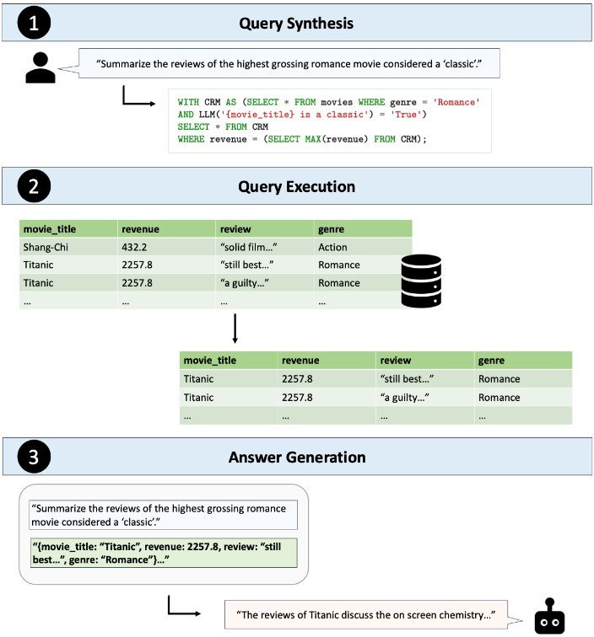
TAG: Beyond Text2SQL
Tabular data is already organized; structured; and can be queried with Structured Query Language (SQL)
Attempts to move to Text2SQL still cumbersome
LLM and a similar approach as RAG lets up lookup Tabular data in a similar way
[2408.14717] Text2SQL is Not Enough: Unifying AI and Databases with TAG

Slide 42
Retrieval Augmented Fine Tuning (RAFT)

Slide 43
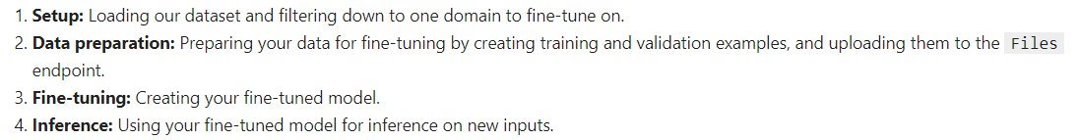
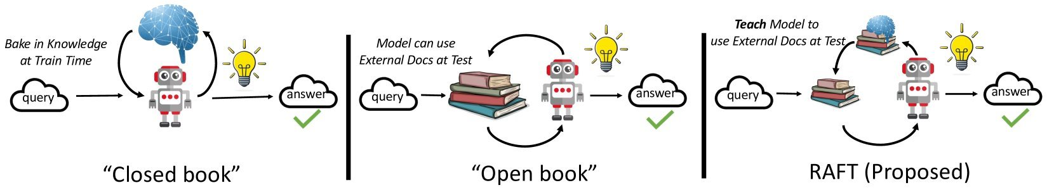
Large Language Models can be Fine Tuned
Fine-tuning is the process of taking a pretrained machine learning model and further training it on a smaller, targeted, domain-specific, data set. The aim of fine-tuning is to maintain the original capabilities of a pretrained model while adapting it to suit more specialized use cases.
RAFT: Adapting Language Model to Domain Specific RAG (arxiv.org)
RAFT (Retrieval Augmented Fine-tuning): A new way to teach LLMs (Large Language Models) to be better at RAG (Retrieval Augmented Generation) (microsoft.com)

Slide 44
Agentic RAG

Slide 45
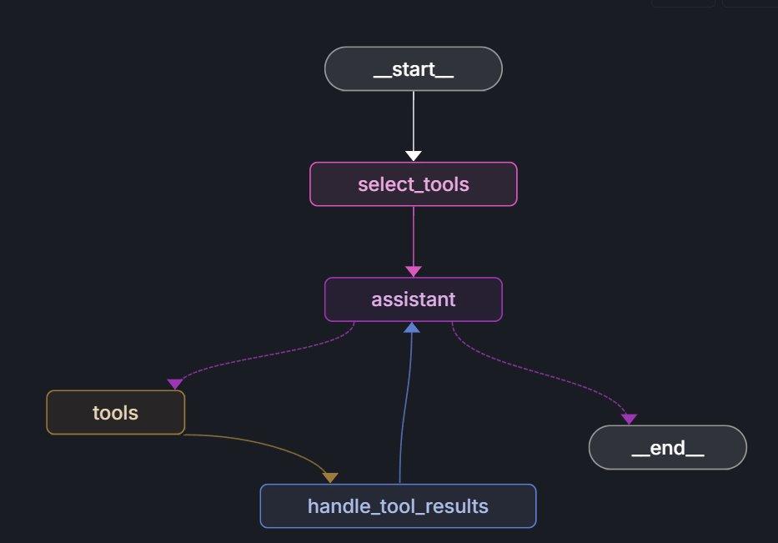
Model Context Protocol (MCP) has tool discovery
Discover tool names and pydantic descriptions
6
RAG

Slide 46
Resources

Slide 47
Open Source Resources
Buddies – Document, Packet
automateyournetwork/Document_Buddy: Chat with various documents - XLSX, DOCX, PPTX, CSV, PDF, TXT - using chatGPT 4 Turbo and Langchain
automateyournetwork/packet_buddy: pcap analysis provided by chatGPT4 Turbo
RAPTORs – Document, Packet
automateyournetwork/Document_RAPTOR: A RAPTOR Tree of your documents used for Language Model Retrieval to chat with the documents!
automateyournetwork/packet_raptor: An AI Assistant using RAPTOR to talk to .pcaps
Knowledge Graphs (GraphRAG) - Document, Packet
automateyournetwork/Document_graphRAG: graphRAG approach with .pcap
automateyournetwork/packet_graph: A Knowledge Graph of a .pcap Packet Capture!
TAG - Packet
automateyournetwork/Packet_TAG: Table Augmented Generation (TAG) with Packet Captures (.pcaps/pcapng)

Slide 48
Live Demo
Q&A

Slide 49

Feedback

