Slide 1
Building Support for an in-house Performance Engineering team One team’s experience
Tim DeLamatre

Slide 2
Let me introduce myself
First technical career was as a mechanical engineer working on propulsion and thermodynamic systems on fighter jets.
After a stint overseas in the US Peace Corps, returned to school to get MS in Information Networking.
Worked for multiple companies, always in a network-focused analytical role, sometimes developing in-house tools to support that role.
2018: after 6 years as a technical lead at Huntington, I became a manager of monitoring, performance testing, and performance engineering teams; ~20 people.
2024: Changed focus to only Event Management and Distributed Performance Engineering teams to drive better outcomes across the organization.
Dad, biker, reader, movie buff, cat servant, >14-gallon blood donor.
@cmhtim, CoachTimD@gmail.com
Notes:
Wrote optimization routines in FORTRAN for air inlet controllers on F-15. Yikes!
Worked mostly in large enterprises so I know that environment well, but I think what we’re talking about today will apply across smaller organizations as well.

Slide 3
Session Goals
Questions we will try to answer:
What does a Performance Engineering (PE) team do?
How can a PE team establish itself?
How can a PE team maintain and expand support from management?
Participation is encouraged!
Share your ideas.
Ask questions.
Notes:
I want this session to be interactive. As I said – this is one team’s experience. What I’m hoping is that we can all contribute and provide ideas to help each other.
How many of you are the only one in your org that really digs into packets?
How many of you are wondering what else you should be doing beyond packet analysis?

Slide 4
What does a Performance Engineering team do?
Who you gonna call?
Notes:
This is absolutely our historical perspective and I think it applies to a lot of you. Our DPE team has been best known for providing tier-4 troubleshooting services based on packet analysis.
But the times are changing. We all know that as encryption levels and traffic volumes have increased, packet analysis provides less insight into the application problems than it used to.
As we go through this session, I’ll talk about how we’ve expanded what we do and remained relevant and useful to the organization.

Slide 5
What does a Performance Engineering team do?
Our team is called Distributed Performance Engineering (DPE).
Our overall service portfolio includes:
Troubleshooting: Analyze data from a wide variety of sources to identify root cause on critical incidents/problems.
WAN Capacity Analysis: Model network impact of personnel moves and application changes to predict potential WAN capacity issues and recommend connectivity upgrades/downgrades as needed.
Application Performance Analysis: Provide predictive performance analysis for applications, regardless of deployment location. Recommend infrastructure and application changes to optimize performance as needed.
Training: Develop materials to educate other teams in troubleshooting techniques and usage of DPE tools.
Notes:
Troubleshooting: As I said earlier, packets were the backbone of what we did when I joined the bank 13 years ago, but we’ve always relied on other sources: Splunk, NetFlow, direct logins to Load balancers, proxies, firewalls, DDOS devices, Application and Infrastructure Monitoring systems, etc.
WAN Cap Analysis: We have used tools that model the network and the impact of new traffic on them, but have more recently relied on statistical modeling to build our own toolset that allows us to perform this function.
App Perf Analysis: Again, some of this work has been done using tools that model app/network behavior, but a lot of the work is around analysis of known workflows, then applying statistical models to predict performance in a new location or with a new traffic pattern. Many of our recommendations here have been around updates to the TCP/IP stack on servers or appliances involved in the workflow.
Training: This is a function that is becoming critically important as the overall organization continues to grow. We’re a team of 4 in a company of >19 thousand employees. The company has seen about 60% growth over the past 10 years. We can not (and do not want to) scale to meet that growth, so we work hard to empower our partners in Operations and support teams so that they can be better equipped to solve some of these issues.
- Firefighter analogy: Firefighter running into a burning building and saving someone gets all the press, but the one who goes into schools and teaches kids not to play with matches, how to check if a door is hot before you open it, and how to put out a grease fire certainly saves more lives. Our team has made its reputation on solving the intractable problems and we work hard to remain the experts, but we’d much rather spend time ensuring that others know how to identify and correct problems sooner, too.

Slide 6
How can a Performance Engineering team establish itself?
History of our team:
2012: A single individual working within Network team.
Focused on manual troubleshooting using Wireshark as primary analysis tool.
Also owned NetFlow collection and small packet broker/capture appliance systems.
Over time, we added team members and technology to deliver improved services:
Added packet capture agents to every desktop and server builds with central management system for retrieving packets.
Moved to full packet broker and network-based packet capture appliance systems covering on-prem and co-located Data Centers.
Added new team members: peak at 5 during merger, now 3, planning to add 1-2 colleagues/contractors in next 4-12 months.
Started providing regular training to wider organization on packet analysis, troubleshooting, and on specific tools we use.
Initiated engagement with application teams to provide them with analysis before deployment whenever possible.
Took ownership of UDP replicator for syslog and Netflow forwarding.
Added Netflow generation and packet capture capability at exit point to Cloud exchange providers for increased visibility on cloud workflows.
2024 - Moved to Operations Organization to align with key partners/customers.
Notes:
As I said earlier, our team started like so many others – one guy (me) working to defend the network from accusations.
Most troubleshooting was manual – 13 years ago, in my 2nd week on the job, we had a huge issue with our reverse proxies (thanks Bluecoat) and I was grinding through packet captures in Wireshark 1.6 or 7 on an underpowered laptop.
We had a few capture appliances attached to a packet broker, but they were in limited areas and didn’t get all the packets we needed.
Over time, we upgraded our packet broker and our capture appliances to get full coverage
Engagement with our application teams provided new avenues for providing value to the whole company.
Training was key to our growth/invluence/reputation in the organization.

Slide 7
How can a Performance Engineering team establish itself?
Key Behaviors contributing to team success
HIRE GREAT PEOPLE!!!
Notes:
We’ll touch on each of these a bit more, but these are what I see as the basic building blocks of a successful practice.
What else have you seen as important factors in being successful?
Of course, the number one thing a PE team can do to be successful is to hire and retain great people. I’ve been lucky enough to be able to do that with my team

Slide 8
How can a Performance Engineering team establish itself?
Key behaviors contributing to the success of the team:
Fact-based analysis:
We can have different opinions about what the facts mean, but we must agree on the facts.
Analysis should always be presented as most likely interpretation of the facts.
Impartiality:
No matter where you sit in the organization, your job is to present the facts and the most likely interpretation, even if that means your department has to own the issue.
Willingness to be wrong:
When new facts are presented, be willing to re-examine your previous conclusions/interpretations and move past them if needed.
Speak up/Don’t wait for perfection!:
Sharing an interpretation even if you aren’t 100% sure could help someone else find the rest of the answer.
Waiting could waste everyone’s time.
Teach others/Training:
Showing others how to do what you do will lead to increased success.
You’re not training your replacement; you’re expanding your sphere of influence.

Slide 9
How can a Performance Engineering team establish itself?
Who should you hire for a high-performing PE team?
Puzzle solvers
Much of what we do depends on having an inquisitive mind.
People with broad technology expertise
Despite the fact that most of us start our performance engineering careers on the network side and moved into analyzing packets, that’s not the only path and a packet-only approach is becoming increasingly limited.
Lifelong learners/adaptability
Even if your team is not big enough to hire from multiple disciplines, you need to identify people who will broaden their skills throughout their careers.
Strong collaborators
Individual effort can lead to breakthroughs, but teamwork is what leads to more consistent outcomes and reputation.
Notes:
These aren’t the only factors to consider but in my experience both as a member of a DPE team and as a leader of the team, these are the building blocks.

Slide 10
How can a PE team gain/retain support from management?
Critical factors that influence management support:
Communication capability:
Stay calm in the face of a storm.
Simplify technical details to ensure management understands how the team is impacting the organization.
Great communication must be developed and practiced.
Proactive problem solving:
Don’t simply solve the problem you’re given but solve (or at least identify and document) the other problems that you see during that engagement.
Example: Found TLS mismatch that was immediate issue on a connection failure but also noted TCP windowing issues. Once the TLS issue was resolved, the TCP issues were included in the report as well, which led to improved performance.
Prioritization:
Identify issues/projects that align with company/organization goals and give priority to any work associated with those efforts.
Innovation:
Don’t rest on your laurels.
Identify opportunities for improvement and pursue them, even if they are not in your “silo”.
Evolve:
Pure packet analysis is likely not enough to sustain a team over time.
Apply your skills across other domains and demonstrate that value to management.
Notes:
The point of Performance Engineering and Analysis is to solve problems – reactively when things are broken, but also capacity analysis, application performance optimization and others. If you can’t communicate your results clearly, your value is diminished. AND IT SHOULDN’T BE!
But communication has to be practiced. When you put together results, practice using
Be assertive – when you see something, say something. I’m an IT oddity in that I am more extroverted than your average engineer so I tend to speak out a lot, but everyone on my team shares the trait of speaking up when they see issues, even if it’s not the problem they were asked to solve. Other teams now call us in just to look at their applications and see if we see any issues, even when they haven’t identified anything specific because they trust us to look broadly.
Reach beyond your assignment: In any organization, but especially in a big one, it’s easy to focus only on your area. This limits your impact and will limit your career. Push the envelope in both tools that you use and areas that you investigate.

Slide 11
How can a PE team gain/retain support from management?
Other factors that contribute to PE team success:
Consistent messaging:
Use standard formats/templates as much as possible.
Always provide outcome of investigations, even if no specific root cause was found.
Follow up with customers/stakeholders to ensure findings were understood.
Relationship-building:
Many organizations operate in silos. Build trust across those silos.
Find opportunities to collaborate with other teams, especially if you can ask them for help with something you’re working on.
Notes:
Relationship-building: Ben Franklin Effect “He that has once done you a kindness will be more ready to do you another, than he whom you yourself have obliged”

Slide 12
Wrap up
What to take away:
Stand firm on the facts.
Don’t defend your silo (without proof).
Communicate clearly.
Be the center for innovative thinking.
As you grow, hire great people.
Notes:
Stand firm on the facts: Your interpretation doesn’t have to be right every time, but you always need to build your analysis from facts.
Don’t defend your silo (without proof): Your reputation will be built on the trust people have in you to tell even the hard stories.
Communicate clearly: PRACTICE PRACTICE PRACTICE. Develop the ability to be the universal translator between technical and non-technical teams.
Be the center for innovative thinking: By helping solve difficult problems, you’ll help your organization more and become a trusted source for other innovative ideas.
As you grow, hire great people: I may have been the one who started our DPE practice, but this team has maintained and grown that reputation.

Slide 13
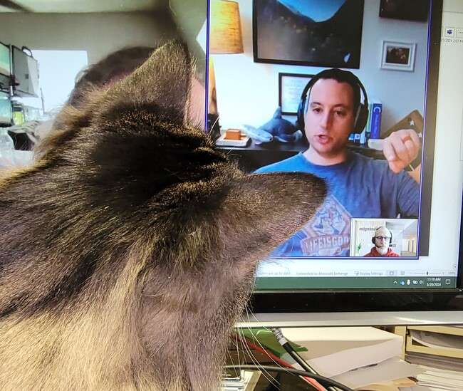
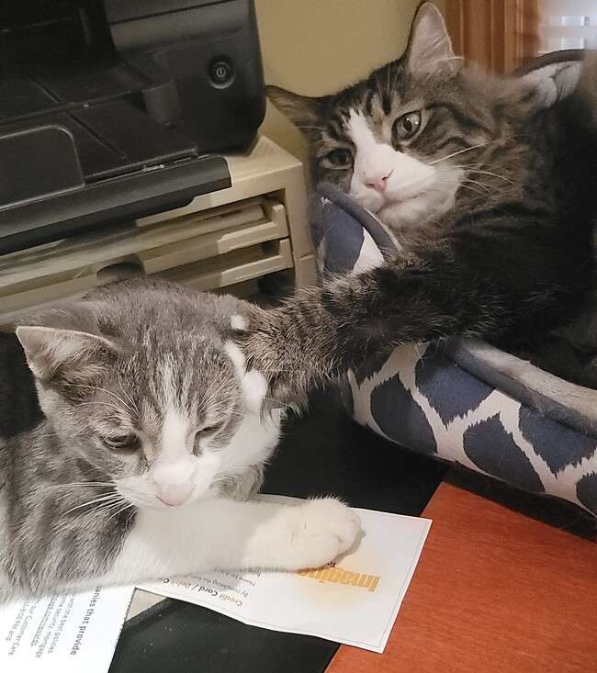
Feedback

